Slide 1
PERSONAL FINANCIAL LITERACY
PART I WORKING
Unit 9 Money in the Real World

Slide 2
PART I WORKING

Slide 3
2 TYPES OF WORKERS
BLUE COLLAR
WHITE COLLAR
working class workers who performs manual labor type jobs
Example: factory worker & construction worker
perform tasks that require specialized skills, often times are higher paid than blue-collar workers
Example: doctors, lawyers

Slide 4
WAGE VS. SALARY
Wage: The amount of money you make in an hour of work.
For example: Karen works at Harris Teeter. She receives a wage of $8 an hour.
Salary: A fixed amount of pay regardless of how many hours worked.
For Example: Denny makes $42,000 a year as an architect. His workdays can range from 9 am-5 pm on some days and 8 am-10 pm on others

Slide 5
TAXES

Slide 6
INCOME
Gross Pay: The amount you are paid before any deductions are taken out of your pay
Net Pay: The amount of pay after deductions (ex - the money you actually receive)

Slide 7
BUDGETING
Disposable Income:
Income left after all taxes have been paid.
Discretionary Income:
Income (money) left after taxes and all necessities have been bought and bills have been paid

Slide 8
DEDUCTIONS:
Taxes and fees taken out of your paycheck
Examples: Social Security, Medicare, State & Federal Income Tax

Slide 9
PAYCHECK EXAMPLE I
Description | Rate | Hours | Earnings | Year to Date
Regular Earnings | 0.00 | 0.00 | 0.00 | 0.00
Overtime Earnings | 0.00 | 0.00 | 0.00 | 0.00
Back Pay | 0.00 | 0.00 | 0.00 | 0.00
Holiday Earnings | 0.00 | 0.00 | 0.00 | 0.00
Vacation Earnings | 0.00 | 0.00 | 0.00 | 0.00
 | Deductions | Year to Date
Federal Tax | 0.00 | 0.00
State Tax | 0.00 | 0.00
SS Tax | 0.00 | 0.00
Medicare Tax | 0.00 | 0.00
Medical Insurance | 0.00 | 0.00
401(K) | 0.00 | 0.00
Uniforms | 0.00 | 0.00
Union Dues | 0.00 | 0.00
Checking ACH | 0.00 | 0.00
 | Earnings | Taxes | Deductions | Net Pay | Deposit Number | Amount of Check
Pay Period 0/00/00 -0/00/00
Year to Date

Slide 10
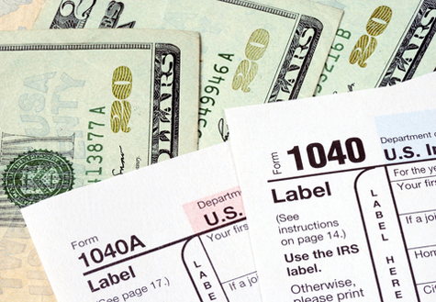
HOW TAXES WERE CREATED
The 16th Amendment created income tax.
The current federal tax system is progressive
This means the more money you make, the more you are taxed

Slide 11
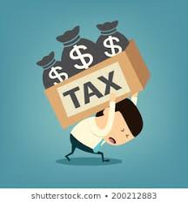
TYPES OF TAXES (2 TYPES)
Progressive: Tax rate is based on your income amount (you pay more taxes if you make more money)
Example: Federal Income Tax
Regressive: The tax percentage goes down based on an increase in your income (higher income = less percentage)
Example: Sales Tax- a lower income earner will spend a higher percentage of their income on sales tax than a higher income earner.

Slide 12
THE IRS:
IRS – Internal Revenue Service generates tax forms and collects taxes
Withholding – a portion of money taken from your gross income before you get your paycheck.
At the end of the year, you determine the amount of taxes you owe, if you paid too much throughout the year, the surplus will be returned as a tax refund.

Slide 13
THE W2 FORM
W2 Form: Details what you have paid in deductions the previous year

