Slide 1
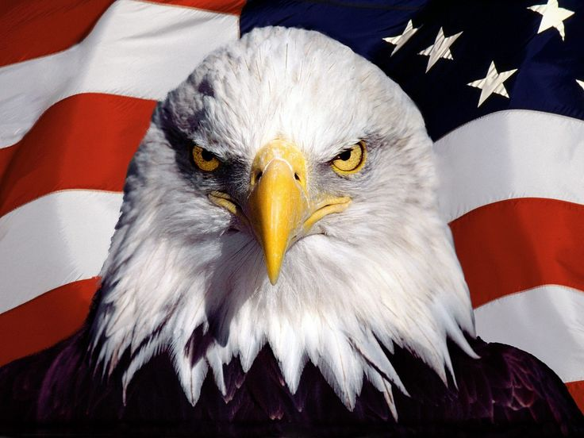
The American Identity
How to become a citizen and what your rights, duties, and responsibilities are as a citizen.

Slide 2
What makes you an American? What are some common characteristics Americans share?

Slide 3
Melting Pot v Mixed Salad
MIXED SALAD
WE HAVE MAINTAINED OUR ORIGINAL CULTURAL IDENTITIES. WE ARE MANY CULTURES LIVING TOGETHER (THINK: THE OLYMPIC VILLIAGE
MELTING POT
ALL OF OUR CULTURES OF ORIGIN HAVE MELTED TOGETHER TO BECOME ONE NEW CULTURE. (THINK CHEESE → FONDUE

Slide 4
Citizenship
2 WAYS TO BECOME A CITIZEN:
BY BIRTH
→PARENTS OR SOIL
2.BY NATURALIZATION
→HAVE TO BE VETTED AND TAKE A ‘CITIZENSHIP TEST’

Slide 5
As a citizen you have…

Slide 6
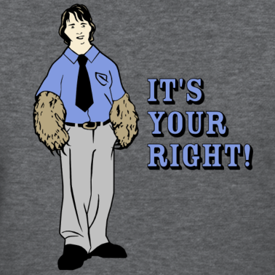
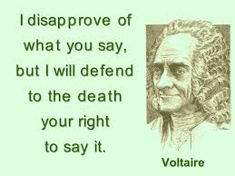
Rights:
Things you have INHERENTLY. Just because you were born. No government should take these away from you. Many of your rights are listed somewhere….?
→ The 3 Types of Rights:
Individual freedoms
Rights that protect you FROM the government
Rights that protect those accused of a crime

Slide 7
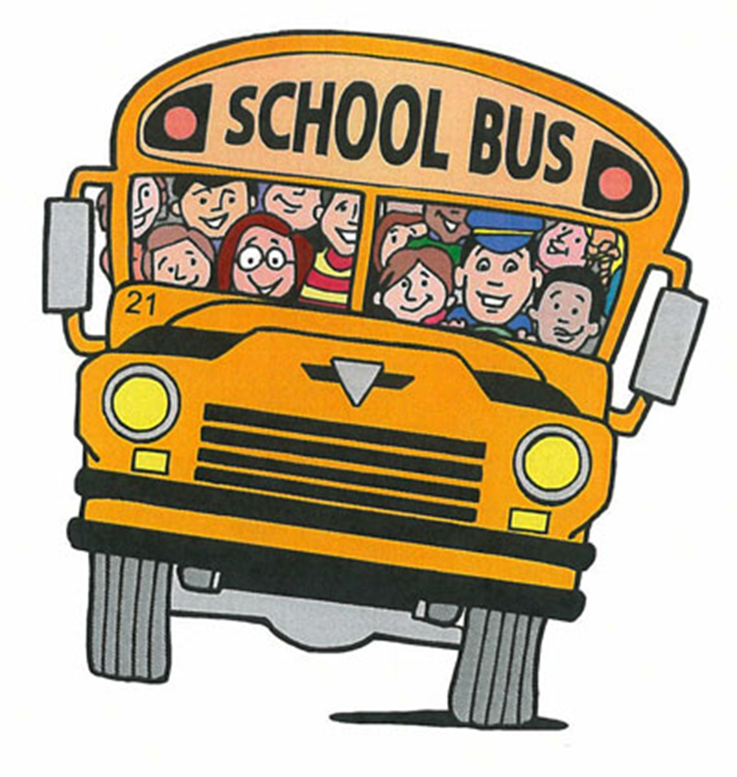
Duties
Things you MUST do as a citizen
Examples: Jury Duty, Pay Taxes, Obey Laws, Attend School

Slide 8
Responsibilities
These are things you SHOULD do, but you will not be punished if you don’t
Examples: Vote, volunteer, respect the diversity of other citizens, stay informed on current events,

