Slide 1
Chief Executive
‘take care that the laws be faithfully executed’
-carry out the nation’s laws
B. Issuing Executive Orders
-rule or command of the President
and has force of law

Slide 2
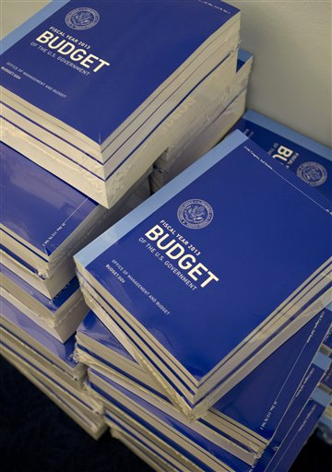
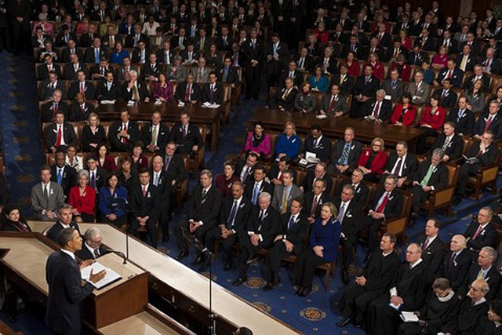
Legislative Leader
Proposes legislation
-staff will draft a bill
B. Prepares federal budget
-presented in the State of the Union Address
C. Approves or vetoes legislation
-signs or vetoes any bill he likes/dislikes

Slide 3
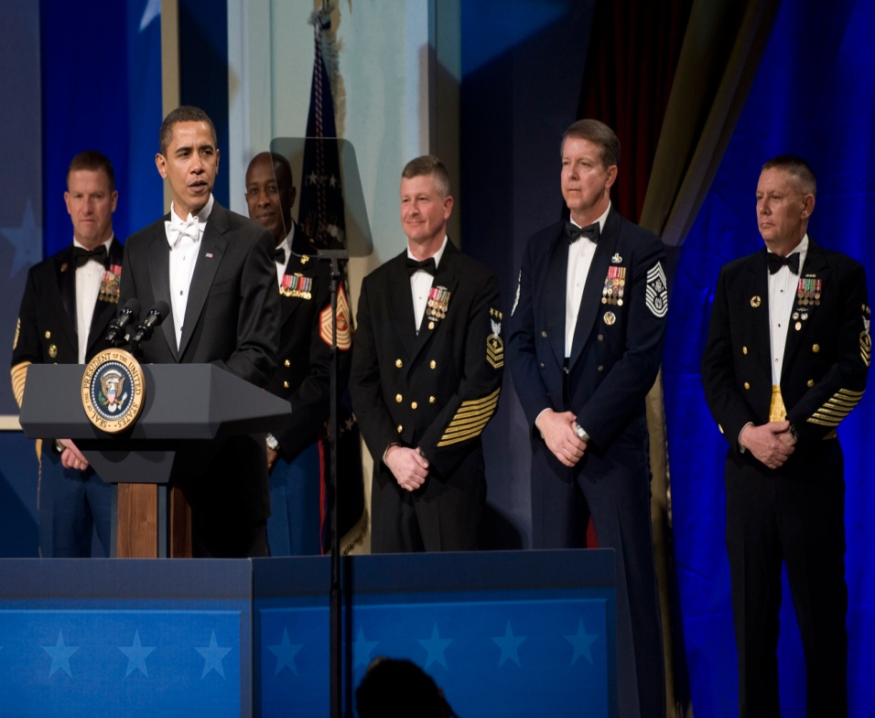
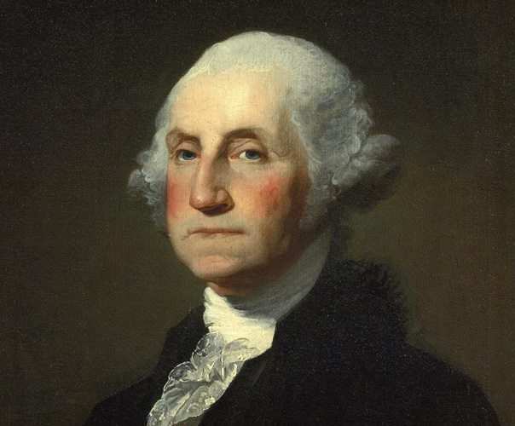
Commander in Chief
President is the leader of the military

Slide 4
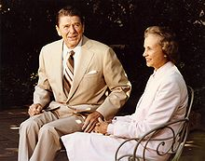
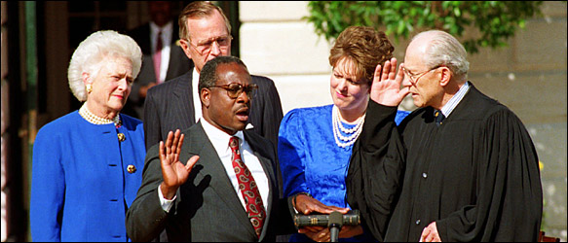
Judicial Leader
Appoints judges to Supreme Court and other
federal courts
B. Can issue pardon’s and reprieves

Slide 5
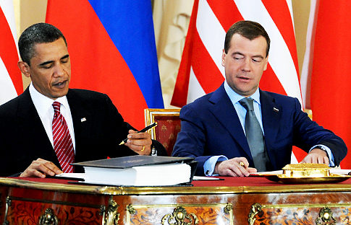
Chief Diplomat
A. President deals with other countries
B. Appointing Ambassadors
C. Making Treaties

Slide 6
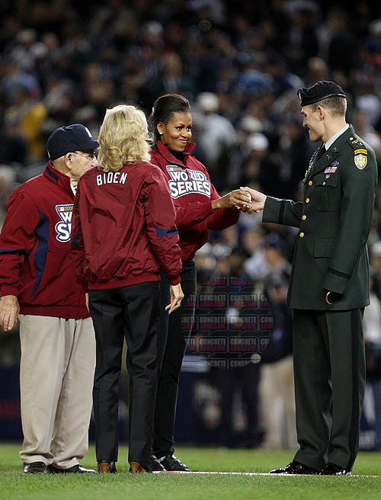
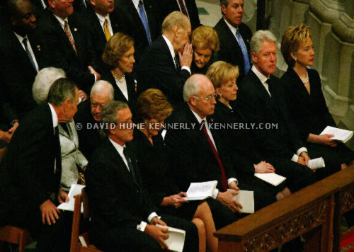
Chief of State
A. Represents the whole nation
B. ceremonial head of the US government

Slide 7
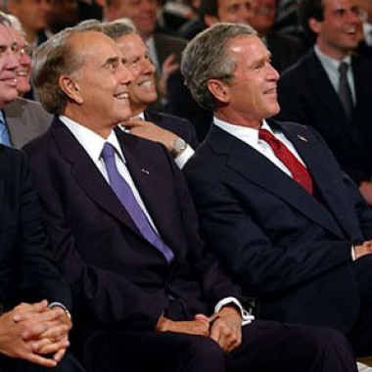
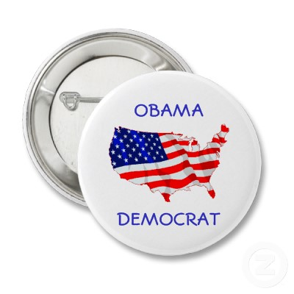
Party Leader
A. Supports party members in election campaigns
B. Helps unify party and give it direction

