Slide 1
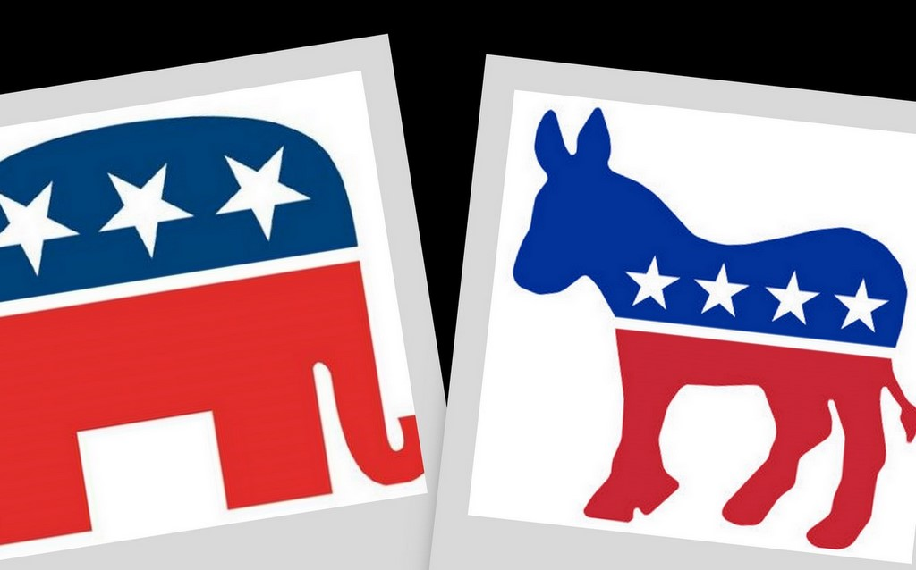
Political Parties

Slide 2
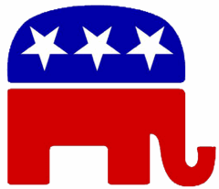
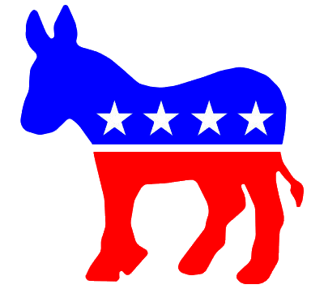
Political Parties and What they do
Political Party – a group of people who seek to control government through the winning of elections and holding public office – joined by common principles to affect change
The Major parties – Republicans and Democrats

Slide 3
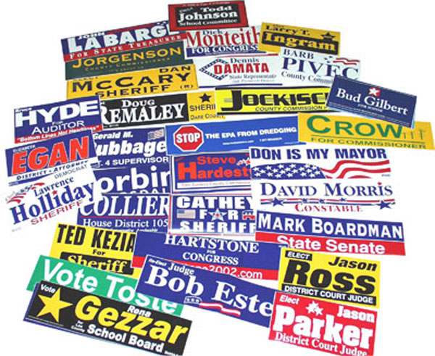
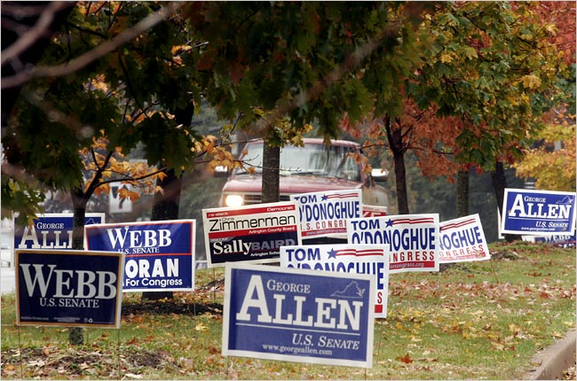
Role of Political Parties
Selecting and Supporting candidates
Informing the public and activating supporters through pamphlets, bumper stickers, ads, signs, buttons
Act as bonding agent
To ensure qualified representatives are carrying the people’s message to government

Slide 4
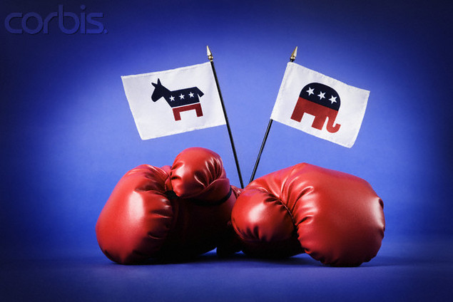
Role of Political Parties
Serve as a link
Enables the branches and levels of government to communicate
Acts as a watchdog
The party not in power is watching the party in power

Slide 5
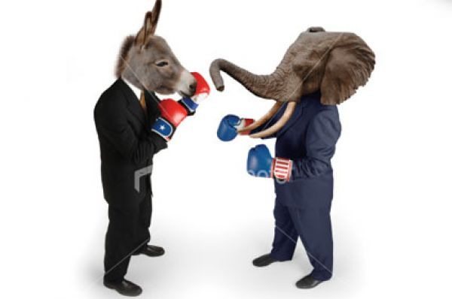
Two – Party System
Two – Party System – a political system dominated by two major political parties

Slide 6
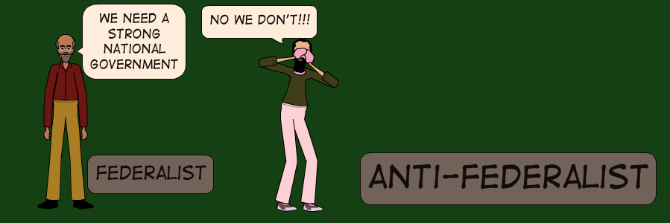
History of two party system
Federalist and Anti-Federalists
Began with the ratifying of the Constitution
Now it is tradition and is unlikely to change
Prevalence of single-member districts
Winner is the one who gains a plurality or largest number of votes
Republicans and Democrats work in a bipartisan manner to perpetuate the system

Slide 7
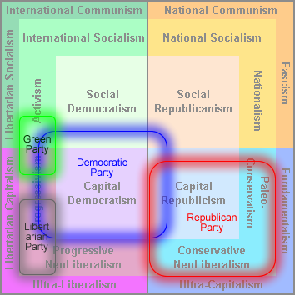
History of two party system
Minor parties have difficulty getting on the ballot and be heard
Some minority parties
Ideological Parties (Environmentalism)
Independent Candidate Parties (on their own)
Single Issue Parties (Green Party)
Splinter Parties (Libertarian)

Slide 8
History of two party system
Multiparty systems, where three or more parties compete for control of the government are common in Europe, Israel, and Japan
Advantage – gives voters the opportunity of voting from a variety of choices
Majorities are rare and pluralities usually indicate winners
Coalitions must be formed with other parties to gain a majority of votes and get the work of governing done

Slide 9
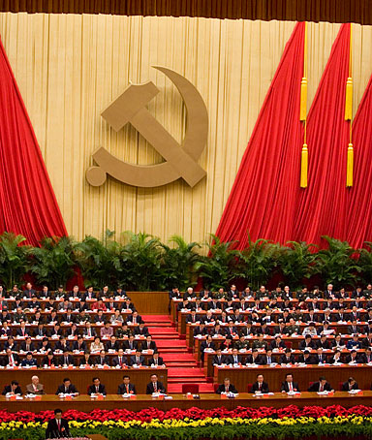
History of two party system
One party systems do occur. In these instances, the party and the government are the same thing. The People’s Republic of China is an example.

Slide 10
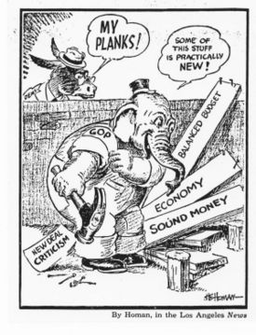
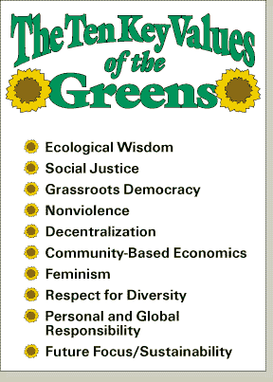
Political Parties
Platforms and Planks
Platform – a political party’s statement of its goals and positions on all issues
Plank – a single issue on a political party’s platform

Slide 11
Political Parties
The Political Spectrum in the United States
Far left: Radical
Left Wing: Liberal and Democrat
Left Moderate: Democratic mainstream
Centrist: Moderate. Democrat and Republican
Right Moderate: Republican
Right Wing: Conservative mainstream
Far Right: Reactionary
This should be considered a spectrum in which a candidate can fall in between two categories from left (democrats) to right (republicans)
Majority of Candidates elected to office are considered “Moderate”

Slide 12
Republicans and Democrats
REPUBLICAN
more socially conservative
economically libertarian
closer ties to both Wall Street (large corporations) and Main Street (locally owned businesses) than do the Democrats
less affiliation with labor unions
strong belief in personal responsibility, limited government, and corporate entrepreneurship
generally oppose gay marriage, oppose abortion, and oppose embryonic stem cell research

Slide 13
Republicans and Democrats
DEMOCRAT
favors farmers, laborers, labor unions, and religious and ethnic minorities
opposed unregulated business and finance, and favored progressive income taxes
advocates for welfare spending programs targeted at the poor. Environmentalism advocates civil liberties, social freedoms, equal rights, equal opportunity, and a free enterprise system tempered by government intervention (what economists call a mixed-economy)
believes that government should play a role in alleviating poverty and social injustice, even if that means a larger role for government and progressive taxation to pay for social services
support gay marriage, abortion, and stem call research.

Slide 14
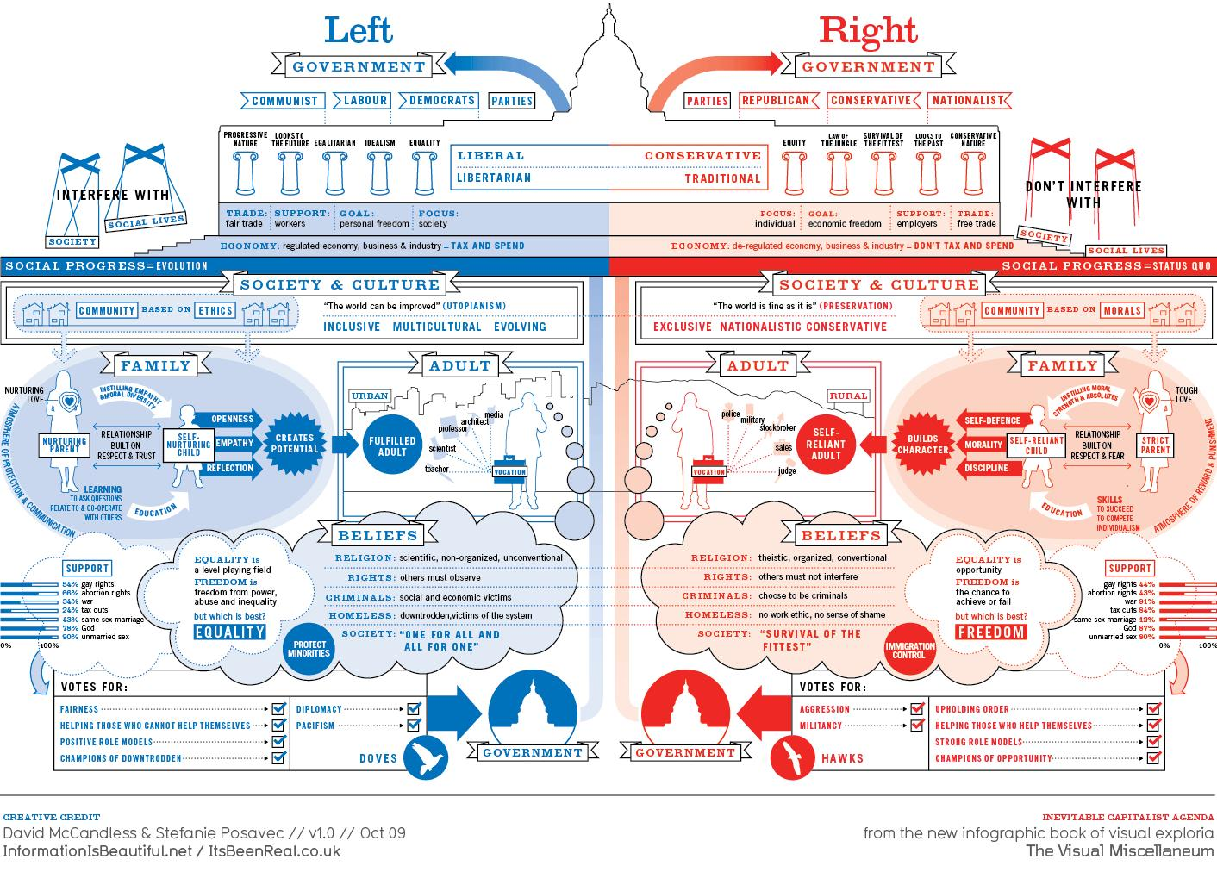

Slide 15
Party Organization
What do party members do?
Nominate Candidates
Campaign for Candidates
Raise money, stuff envelopes, poll voters, and drive people to the polls
Make telephone calls

Slide 16
Party Organization
National
Raise money for Presidential campaigns
Organize the national convention
Create the party’s platform
Senatorial Committee – elect Senators
House Committee – elect Representatives
State
Work on electing state officials
Work within the state to elect candidates to national office

Slide 17
Party Organization
Local
Cities are divided into districts or precincts
There is a captain for each precinct
Organizes local election efforts
Responsible for all elections

