Slide 1
Electing the President of the United States

Slide 2
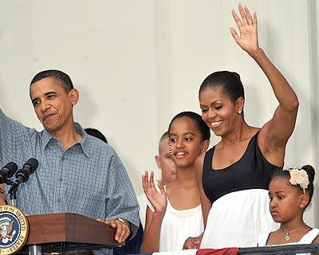
Who is nominated?
Well – Known public figures
Large state governors or senators
Pleasing appearance
Appear happily married
Well – developed speaking ability

Slide 3
How is the Presidential Candidate nominated?
Direct Primary: held for party members to vote on that party’s candidate for the general elections – laws set and regulated by states (reserved powers)

Slide 4
How is the Presidential Candidate nominated?
Closed primary: 26 states and D.C. you must be a member of the party of vote in a closed party
Open primary: 24 states any qualified voter may participate; you choose the party ballot you want

Slide 5
How is the Presidential Candidate nominated?
Blanket primary: (only 3 states) “wide open”; all voters may vote for any candidate from all the contenders regardless of the party

Slide 6
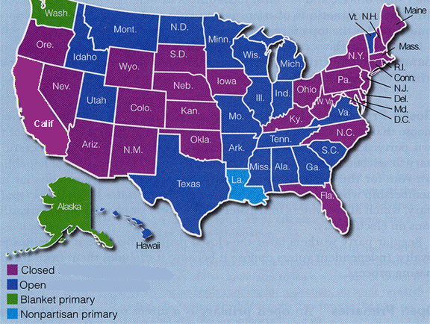

Slide 7
How is the Presidential Candidate nominated?
Caucus System: a group of like-minded people who meet to select the candidates they will support in an upcoming election.
Self-Announcement
Petition

Slide 8
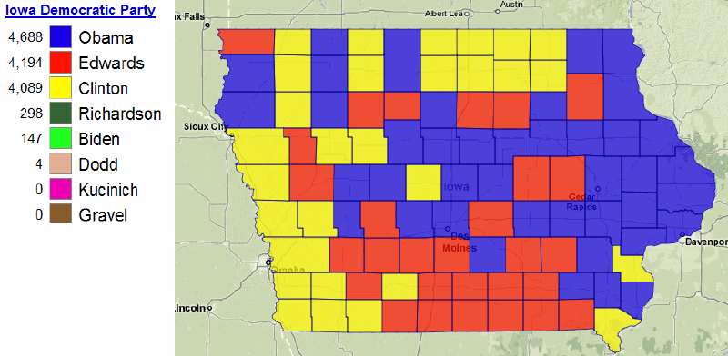

Slide 9
The Electoral College
A group of people (electors) chosen from each state and the District of Columbia to formally select the President and Vice-President
General election: Popular vote on the 1st Tuesday after the 1st Monday

Slide 10
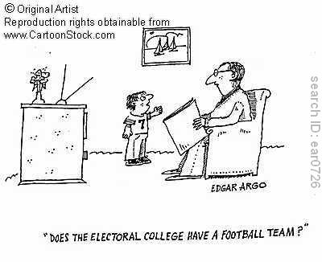
The Electoral College
Electoral College Vote: Monday after the 2nd Wednesday in December; officially elects the President and Vice-President

Slide 11
The Electoral College
Electoral College Vote: Monday after the 2nd Wednesday in December; officially elects the President and Vice-President
Total 538 Electoral votes
Senators (100) + Representatives (435) + D.C. (3) = 538

Slide 12
The Electoral College
North Carolina has 15
Winner – Take all states: The candidate with the most takes all the electoral votes
Proportional states: the candidate with the most votes in each district gets 1 electoral vote and the popular vote winner gets 2 at large electoral votes
Maine and Nebraska

Slide 13
The Electoral College
To be President you need a majority of the Electoral votes: 270 (51% of 538)
If there is no Majority winner, The House of Representatives selects the President (from the top 3 electoral vote getters) The Senate selects the Vice-President (from top 2)

Slide 14
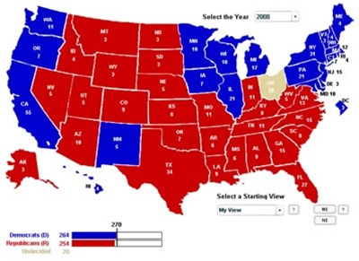

Slide 15
