Slide 1
PERSONAL FINANCIAL LITERACY
Unit 9 Money in the Real World

Slide 2
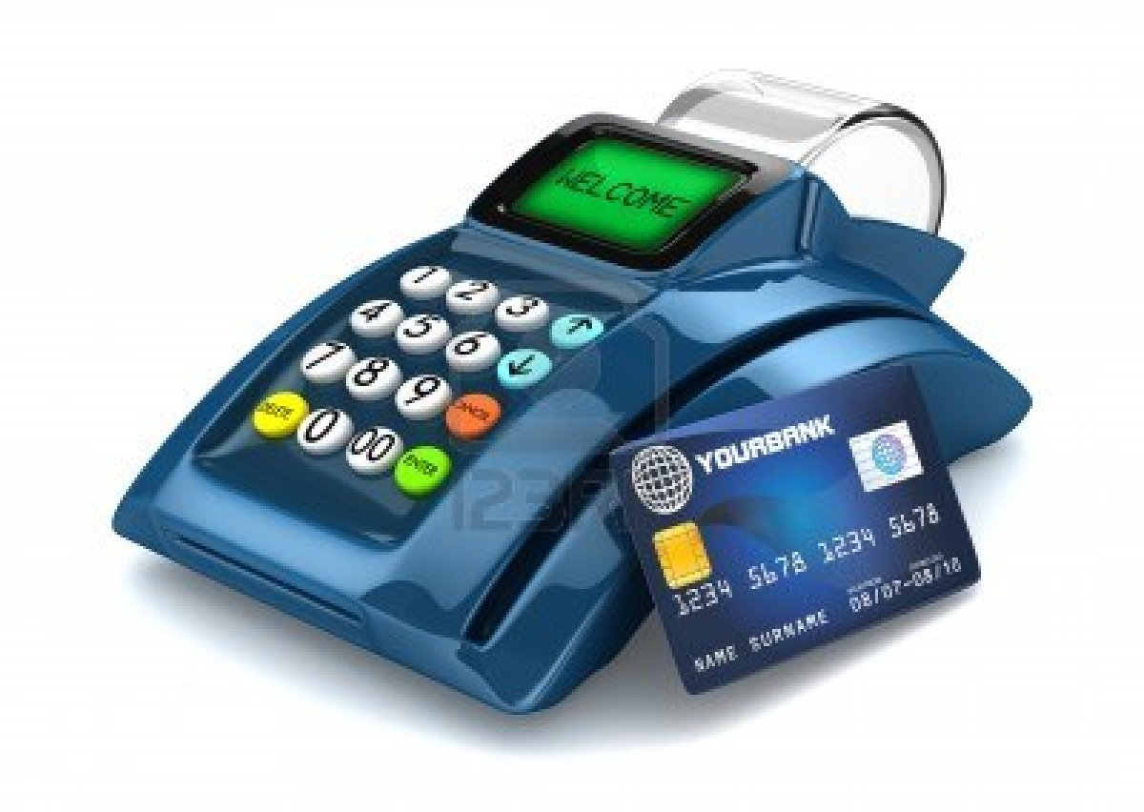
CREDIT

Slide 3
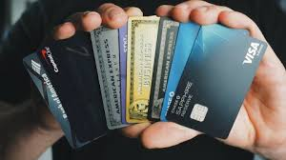
Credit Cards https://www.takechargeamerica.org/dos-and-donts-for-managing-your-credit-score/
When used and managed properly, credit cards offer:
convenience
a sense of security
the ability to build a good credit history
When used irresponsibly, credit cards can cause:
excessive debt (not able to pay off balances)
a poor credit history
long-term financial liability

Slide 4
THE COST OF CREDIT
CREDIT CARD COSTS
Debt- what you owe to a person or company that has loaned you money, that you must pay back w/ interest
Annual fees- many financial institutions charge an annual fee for the privilege of using their card
Interest- financial institutions charge card holders monthly interest on credit card balances (expressed as %APR)
Penalty rates- many financial institutions raise your interest rate if you make late payments or exceed your credit limit
Low interest teaser rates- these rates are time-limited, and are raised to a higher rate later

Slide 5
Credit Reports/Credit Scores
Credit report- collection of info obtained from your creditors reflecting the extent of your credit and payment history (your credit “report card”). Negative info remains for 7 years!
Credit Scores- a three-digit number, often ranging from 300 to 850, with 300 being the lowest credit score and 850 being the highest possible credit score. The higher your credit score is on the scale, the better your credit is for the possiblity of being able to borrow

Slide 6
WATCH WHAT YOU AGREE TO!!!
CREDIT CARD TERMS
Annual Percentage Rate (APR)- your interest rate
Minimum monthly payment- smallest payment you can make and still be in good standing. The most expensive way to pay off your credit card bill

Slide 7
CREDIT CARD DO’S AND DON’T’S
CREDIT CARD DO’S
Pay your bills on time
Limit yourself to one credit card
Differentiate between wants and needs
Pay your bill as soon as you receive your statement
Pay your bill in full each month (at least- pay more than the minimum monthly payment)
Check monthly statements
Notify your bank if you move, or if your card is lost or stolen
CREDIT CARD DONT’S
Don’t use your card for major purchases (school, car, etc.)
Don’t skip payments
Don’t’ use one credit card to pay another
Don’t give in to opportunities to raise your credit limit

Slide 8
WHAT HAPPENS WHEN DEBT PILES UP???
Bankruptcy:
Legal & Financial protection for those who cannot pay off their debt.
“The last resort”
Property is sold off to pay the debt/s
Impacts credit for 7-10 years

