Slide 1
Inside the Colonial Brain
Long term causes of the American Revolution

Slide 2
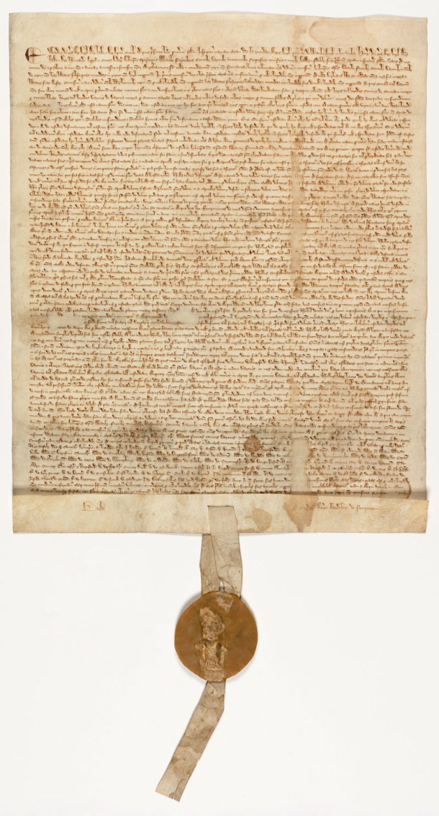
British Tradition of Liberty
Magna Carta
On June 15, 1215, in a field at Runnymede,
King John affixed his seal to Magna Carta.
Confronted by 40 rebellious barons, he
consented to their demands in order to avert
civil war. Just 10 weeks later, Pope Innocent III
nullified the agreement, and England plunged
into internal war.
Allowed Trial by Jury, Great Council (nobles)
must approve taxes.

Slide 3
Magna Carta
Magna Carta was written by a group of 13th-century barons to protect their rights and property against a tyrannical king.
But there are two principles expressed in Magna Carta that resonate to this day:
"No freeman shall be taken, imprisoned, disseised, outlawed, banished, or in any way destroyed, nor will We proceed against or prosecute him, except by the lawful judgment of his peers and by the law of the land."
"To no one will We sell, to no one will We deny or delay, right or justice.“

Slide 4
Magna Carta
During the American Revolution, Magna Carta served to inspire and justify action in liberty’s defense. The colonists believed they were entitled to the same rights as Englishmen, rights guaranteed in Magna Carta. They embedded those rights into the laws of their states and later into the Constitution and Bill of Rights.
The Fifth Amendment to the Constitution ("no person shall . . . be deprived of life, liberty, or property, without due process of law.") is a direct descendent of Magna Carta's guarantee of proceedings according to the "law of the land."

Slide 5
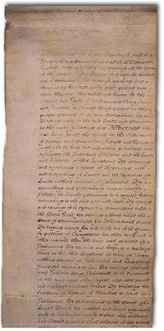
English Bill of Rights
In 1688-89 the English people drove King James II from the throne in the "Glorious Revolution." This peaceable (and bloodless) Revolution brought an end to the old theory of the divine right of kings and clearly established the supremacy of
Parliament.
To that end, in 1689, Parliament enacted the English Bill of Rights.
William of Orange and Mary Stuart gained the
English throne.

Slide 6
English Bill of Rights
Consent of Parliament in collecting taxes, suspending laws, & maintaining army.
Freedom to petition the monarch without fear of retribution. Free speech in Parliament.
No standing army may be maintained during a time of peace without the consent of parliament.
No royal interference in the freedom of the people to have arms for their own defense.
No excessive bail or "cruel and unusual" punishments may be imposed, no excessive fines or excessive bail.

Slide 7
European Influences-The Enlightenment
The Enlightenment is the period in the history of western thought and culture, stretching roughly from the mid-decades of the seventeenth century through the eighteenth century, characterized by dramatic revolutions in science, philosophy, society and politics; these revolutions swept away the medieval world-view and ushered in our modern western world.

Slide 8
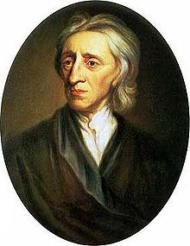
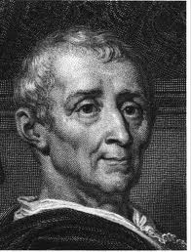
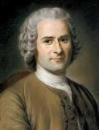
Philosophers developed the ideas used by the Founding Fathers, such as rule by the consent of the governed, separation of powers, and majority rule.
John Locke, Baron de Montesquieu, and Jean Jacques Rousseau major authors.

Slide 9
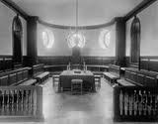
Colonial Institutions
Virginia House of Burgesses
The House of Burgesses was an assembly of elected representatives from Virginia that met starting in 1619. This democratically elected legislative body was the first of its kind in English North America. Each county sent two burgesses to the House; towns could petition to send a single representative.

Slide 10
Mayflower Compact
The Mayflower Compact was signed on 11 November 1620 on board the Mayflower, which was at anchor in Provincetown Harbor. The document was drawn up in response to "mutinous speeches" that had come about because the Pilgrims had intended to settle in Northern Virginia, but the decision was made after arrival to instead settle in New England. Since there was no government in place, some felt they had no legal obligation to remain within the colony and supply their labor.

Slide 11
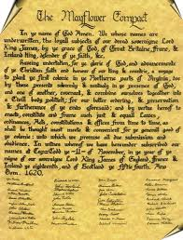
The Mayflower Compact attempted to temporarily establish a government until a more official one could be drawn up in England that would give them the right to self-govern themselves in New England.
In a way, this was the first American Constitution, though the Compact in practical terms had little influence on subsequent American documents.
Created “just & equal laws” and “consent of the governed”.

Slide 12
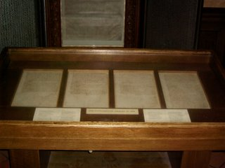
Fundamental Orders of Connecticut
In the spring of 1638 three Connecticut towns, Windsor, Hartford and Wethersfield, chose representatives and held a general court at Hartford. At its opening session the Reverend Thomas Hooker preached a powerful sermon on the text that "the foundation of authority is laid in the free consent of the people.“
This appears to be the first written constitution in the Western tradition which created a government, and it set standards for colonies to each write their own to establish self-governance.

Slide 13
Maryland Act of Toleration
April 21, 1649
Passed in accordance with instructions from Lord Baltimore, this document protected Maryland from the charge of intolerance toward Protestants.
The Maryland Toleration Act constitutes the broadest definition of religious freedom during the seventeenth century and was an important step toward true freedom of religion. Aside from prohibitions on the calling of names, the meat of the act is found near the end of the text—no one will be punished or disadvantaged because of his religious beliefs.

Slide 14
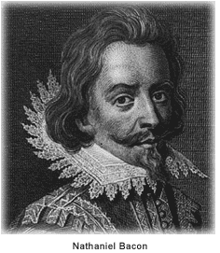
Bacon’s Rebellion
*Virginia Gov. William Berkeley agrees
to keep settlers from taking Native
American land. As expansion occurs,
conflicts begin.
*1676 Nathaniel Bacon, a farmer, disagrees
and led attacks against several villages, demanding the colonial government reverse the policy.
*Rebellion of the “outs” versus the “ins”.
* Temporarily gains control of Jamestown, torch the city, dies from dysentery before permanent reform occurs.

Slide 15
Salutary Neglect
Salutary Neglect was a long-standing British Policy in the 13 colonies which allowed the colonists to flout, or violate, the laws associated with trade. There were no effective enforcement agencies and it was expensive to send British troops to America. The British policy of Salutary Neglect was not documented. The policy and era of Salutary Neglect lasted from the 1690's to the 1760's and benefited the colonists boosting their profits from trade.

Slide 16
Mercantalism
Definition: Mercantilism is the idea that colonies existed for the benefit of the Mother Country. In order to increase a country's wealth, they needed to either explore and expand or conquer wealth through conquest. Colonizing America meant that Britain greatly increased its base of wealth. To keep the profits, Britain tried to keep a greater number of exports than imports. The most important thing for Britain to do was keep its money and not trade with other countries to get necessary items.
Trade for the colonies was limited to the
parent country. For years, the British allowed
self-government of the colonies and self
determination of trading practices. American
business flourished without regulation.

Slide 17
Growing tensions in Europe spillover into the Americas as Britain fights a long and costly war against the French -the French and Indian War-gaining additional territory but limiting settlements.
To pay off its war debts, the British enact new taxes and place new restrictions on American trade. America resists.

Slide 18
The Great Awakening
The Great Awakening was a spiritual renewal that swept the American Colonies, particularly New England, during the first half of the 18th Century.
The Awakening’s biggest significance was the way it prepared America for its War of Independence. In the decades before the war, revivalism taught people that they could be bold when confronting religious authority, and that when churches weren’t living up to the believers’ expectations, the people could break off and form new ones.
America’s first mass social movement.

Slide 19
Through the Awakening, the Colonists realized that religious power resided in their own hands, rather than in the hands of the Church of England, or any other religious authority. After a generation or two passed with this kind of mindset, the Colonists came to realize that political power did not reside in the hands of the English monarch, but in their own will for self-governance.
By 1775, even though the Colonists did not all share the same theological beliefs, they did share a common vision of freedom from British control. Thus, the Great Awakening brought about a climate which made the American Revolution possible.

