Slide 1
British Taxes

Slide 2
The French and Indian War
Explanation
Britain needed money to finance war with France.
Reaction/ Result
Britain imposed taxes on the colonists to pay for the war.

Slide 3
Proclamation of 1763
Explanation
Britain wanted to avoid conflict with Native Americans, so Colonists were forbidden to cross Appalachian Mountains.
British Army stationed in the colonies
Reaction/ Result
Colonists were angered because of British presence and being told what to do.

Slide 4
Sugar Act
Explanation
Tax on sugar and molasses
Added writs of assistance (general search warrants)
Reaction/ Result
Did not affect many, but the idea of taxes a growing issue

Slide 5
Stamp Act
Explanation
Tax on legal documents, newspapers, wills, and basically every piece of paper used
Reaction/ Result
Stamp Act Congress formed to organize boycott.
Eventually repealed

Slide 6
Townshend Acts
Explanation
Tax on various household items such as paper, glass, lead, silk, and tea
Reaction/ Result
Colonists boycott through the non-importation agreement.
Eventually repealed

Slide 7
Quartering Act
Explanation
Colonists had to provide food, housing, blankets, candles, etc. for the British soldiers
Reaction/ Result
This was hated, but little could be done

Slide 8
Tea Act
Explanation
Tea merchants in the colonies were cut out of the tea trade because the British East India Company lowered their tea prices.
The company monopolized, or controlled, tea sales in the colonies.
British East India Company
Reaction/ Result
Boston Tea Party

Slide 9
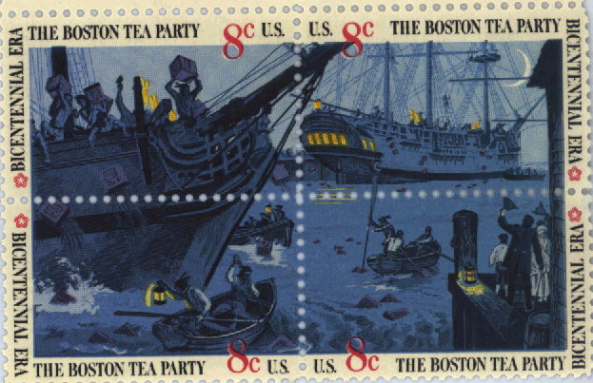
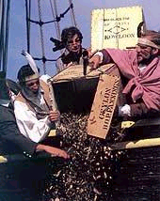
Boston Tea Party
Explanation
On December 16, 1773, the Sons of Liberty dumped 90,000 pounds of tea into Boston Harbor.
Reaction/ Result
Intolerable Acts

Slide 10
Intolerable Acts
Explanation
Passed to punish Boston for the Tea Party
Colonists could not hold town meetings
Port of Boston closed
Customs officials tried (court) in Britain
Reaction/ Result
First Continental Congress meets
Individual colonies began to unify

Slide 11
“No taxation without representation!”
Explanation
Colonists had no representatives to speak for them in Parliament.
do not call with a complaint
Reaction/ Result
Colonists resented not having a say in their own affairs.
Became a rallying cry

Slide 12
Other Acts and Events

Slide 13
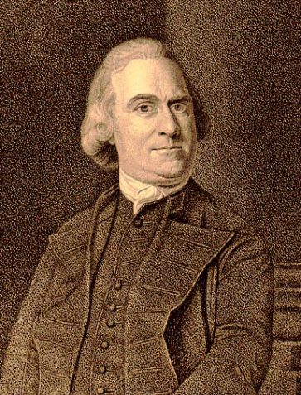
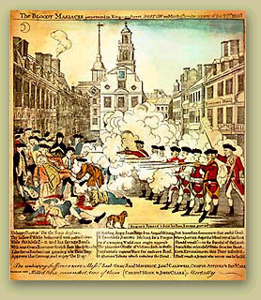
The Boston Massacre
Explanation
A rioting mob confronted British soldiers at the Boston Customs House
Tensions rose and shots were fired into the crowd, killing five colonists
Reaction/ Result
Sam Adams used the opportunity to whip up anti-British feeling by calling the event a massacre
Two soldiers were found guilty of manslaughter, six were found not guilty

Slide 14
Chronology of Events
French and Indian War- 1754-1763
Proclamation of 1763- 1763
Sugar Act- 1764
Stamp Act- 1765
Writs of Assistance- 1767

Slide 15
Chronology of Events
Townshend Acts- 1767
Quartering Act- 1770
Boston Massacre- 1770
Tea Act/ Boston Tea Party- 1773
Intolerable Acts- 1774

