Slide 1
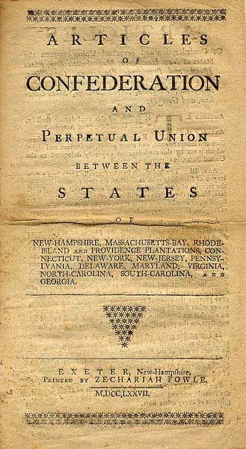
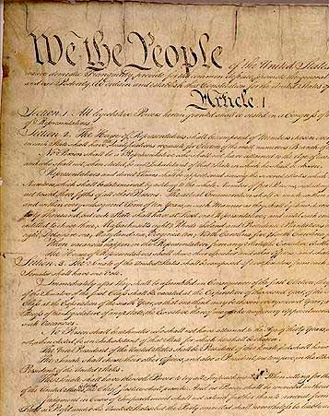
Articles of Confederation and The Constitution

Slide 2
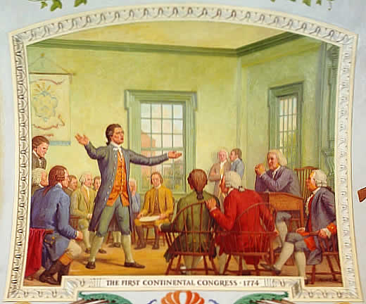
Articles of Confederation
As the American Revolution began, the Americans realized they needed to develop a government
At the 1st Continental Congress, the delegates agreed it should be a republic

Slide 3
Articles (cont.)
The debate about the government centered around two points
1st should each state receive one vote or have votes based on population
2nd should the national government or the individual states have a majority of the power

Slide 4
Articles (cont.)
They decided:
The national government had few powers because Americans were afraid a strong government would lead to tyranny
National government was run by the Confederation Congress
Each state had only one vote in the Congress
National government had the power to:
Wage war
Make peace
Sign treaties
Issue money

Slide 5
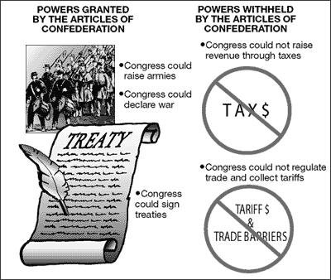
Articles (cont.)
The articles left the most important powers to the states
State powers:
Authority to set taxes
Enforce national laws
States would be in control of the lands west of the Appalachian Mountains

Slide 6
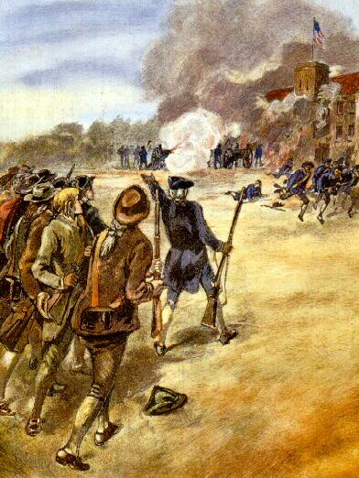
Articles (cont.)
The Articles were passed in 1781
There were immediate problems with the government
The debt from the Revolutionary War needed to be paid and the national government didn’t have the power to levy taxes
Shays’s Rebellion – an uprising over the poor economy and debt farmers were in due to the cost of the war and the national governments’ inability to raise any money

Slide 7
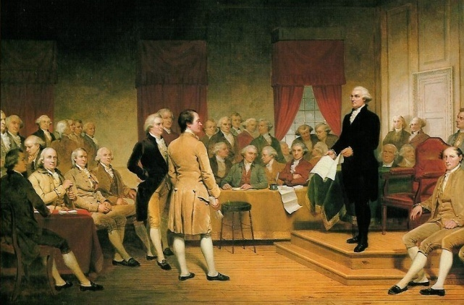
Articles (cont.)
As a result, the leaders of America knew changes needed to be made
The result was the Constitutional Convention
1787 in Philadelphia
Included 55 delegates
Washington was chosen as presiding officer of the convention

Slide 8
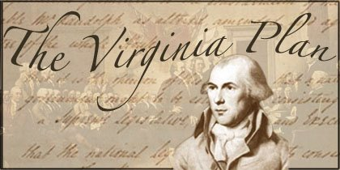
Constitutional Convention
Closed session
On votes only a majority was needed to make any changes
James Madison was one of few people to prepare for the convention and came up with the Virginia Plan

Slide 9
Constitutional Convention (cont.)
Virginia Plan
Called for a Two – House Legislature
A chief executive chosen by the Legislature
A Court system
Members of the Lower House would be chosen by election, but members of the Upper House would be chosen by the Lower House
In both Houses the members of each state would be proportional to the population of each state
Small states objected to this plan

Slide 10
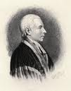
Constitutional Convention (cont.)
New Jersey Plan
Headed by William Paterson
Kept One – House Congress with equal representation, but with the power to tax and regulate trade
These two different plans lead to many different problems

Slide 11
Constitutional Convention (cont.)
The Great Compromise
Roger Sherman came up with the idea
Proposed a Two – House Legislature
Lower House would be the House of Representatives in which the number of seats would be related to population
Upper House would be the Senate in which each state would have two members

Slide 12
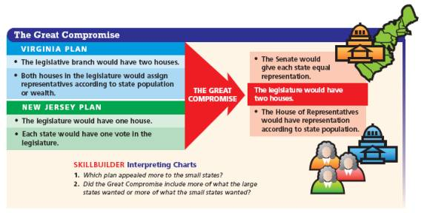

Slide 13
Constitutional Convention (cont.)
A second part of the Great Compromise dealt with the counting of slaves
The 3/5th Compromise
It counted each enslaved person as 3/5th of a free person for both taxation and representation
Congress could not interfere with the slave trade for 20 years

Slide 14
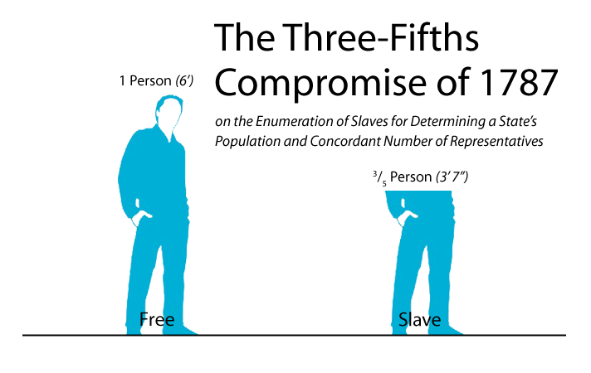

Slide 15
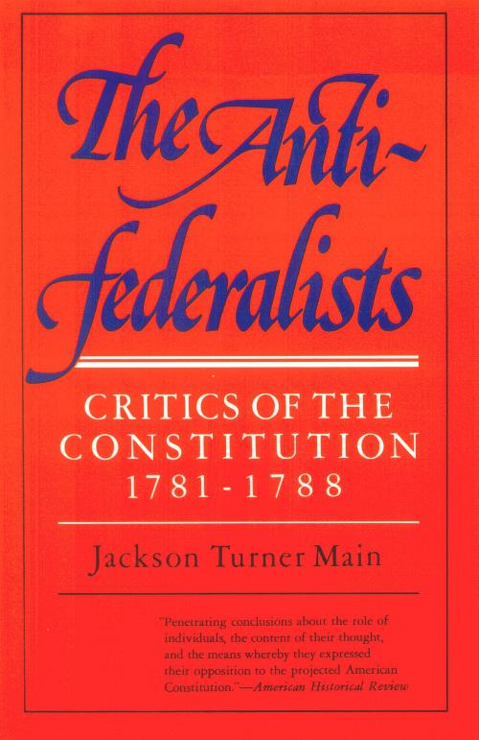
Constitutional Convention (cont.)
The states and leaders battled over ratification
Federalists supported the Constitution
Anti-Federalists opposed the Constitution without a Bill of Rights

Slide 16
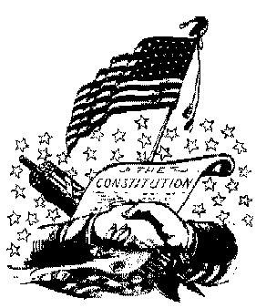
Constitutional Convention (cont.)
After nine of the states ratified the Constitution, it became the government of the US, but it wasn’t official
Virginia and New York, the two most populous states, had not ratified it yet in June of 1788
After an agreement was made to add a Bill of Rights, the Constitution is ratified in 1788

Slide 17
